Slide 1
C. DICKENS’ SOCIETY AND TODAY: COMMON PROBLEMS

Slide 2
TABLE OF CONTENTS:
Introduction
Child abuse
Poverty and malnutrition
Bad education
Close mentality appearances and prejudices
Sources

Slide 3
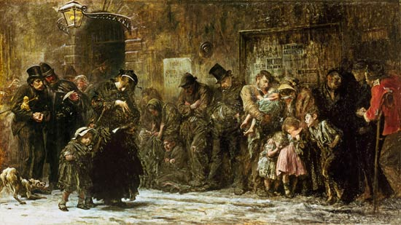
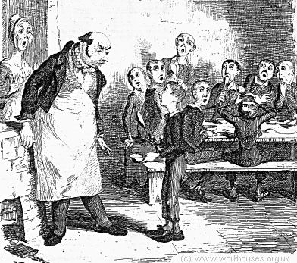
INTRODUCTION
Charles Dickens criticized a lot of social problems in his novels. There were typical social problems of his times, but they also characterize the society of today.

Slide 4
CHILD ABUSE
C. DICKENS’ NOVELS
TODAY PROBLEMS
Oliver Twist and his companions suffered the tortures of slow starvation for three months. (Oliver Twist, Chapter 2)
That boy will be hung. (Oliver Twist, Chapter 2)
Girl number twenty […] Sissy is not a name; don’t call yourself Sissy. (Hard Times, Chapter 2)
There are a lot of cases of child abuse in kindergartens and in grade schools.
Children must work all day in terrible living conditions in a lot of countries.

Slide 5
POVERTY AND MALNUTRITION
C. DICKENS’ NOVELS
TODAY PROBLEMS
He was desperate with hunger. (Oliver Twist, Chapter 2)
I passed the day in a ditch, and the night in a pigsty. (Hard Times, Chapter 4)
I was so sickly, that I was always moaning and groaning. I was so ragged and dirty, that you wouldn't have touched me with a pair of tongs. (Hard Times, Chapter 4)
Unemployment and poverty are commons problems in all world.
Many children suffer from hunger and live in huts.
A lot of unemployed people have not a house.

Slide 6
BAD EDUCATION
C. DICKENS’ NOVELS
TODAY PROBLEMS
Little pitchers before him, who were to be filled so full of facts. (Hard Times, Chapter 2)
Girl number twenty unable to define a horse. (Hard Times, Chapter 2)
In many places children cannot go to school.
In some schools children are educated to learn what people say them and not to think with their mind.

Slide 7
CLOSE MENTALITY, APPEARANCES AND PREJUDICES
C. DICKENS’ NOVELS
TODAY PROBLEMS
A man who could never sufficiently vaunt himself a self-made man. […] A man who was the Bully of humility. (Hard Times, Chapter 4)
‘What is your father?’ ‘He belongs to the horse-ridding, if you please, sir’.[…] ‘Very well then. He is a veterinary surgeon, a farrier and horsebreaker.’ (Hard Times, Chapter 2)
A man of realities. A man of fact and calculations. (Hard Times, Chapter 2)
Poor people or strangers are discriminated .
For a lot of people is important to appear more than what they are.
People usually do not accept what is criticized by the traditional morality.

Slide 8
SOURCES:
‘PERFORMER CULTURE & LITERATURE 1+2’
‘MARILENA BELTRAMINI-SCHOOLWORK’

Slide 9
THANKS FOR WATCHING

